Slide 1



#1 How to traverse files & subfolders of given directory??
1
Java Interview
#javainterview

Slide 2

How to traverse files & subfolders of given directory??
2
Java Interview
#javainterview
#javarefreshed

Slide 3
PURPOSE
Solving real time programming problems
Using Java API only, no 3rd party library
Using and exploring latest java features
Focusing on interview type questions
By the time we will have good java interview question bank

Slide 4
How to filter specific files while reading from given directory??
3
Java Interview
#javainterview

Slide 5
How to read big size files efficiently?
4
Java Interview
#javainterview

Slide 6
What is the Role of Class loader
5
Java Interview
#javainterview

Slide 7
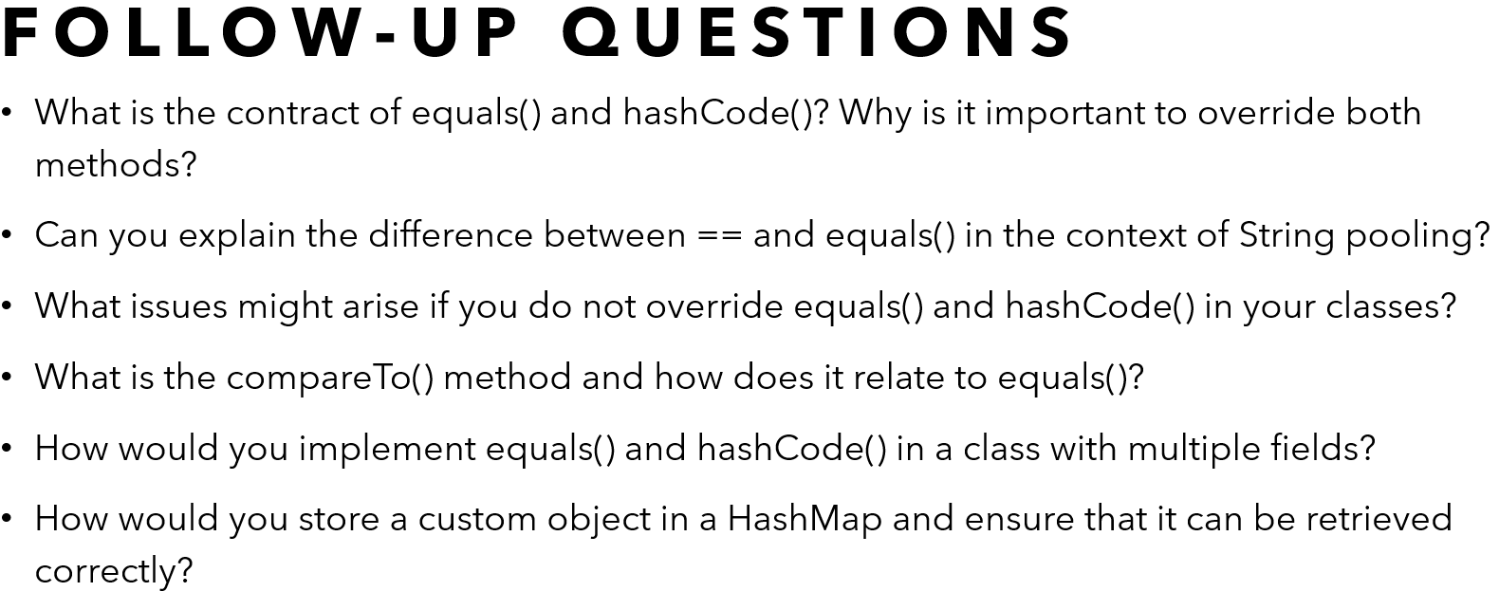
Explain the difference between == and equals() in Java. **all related questions covered
6
Java Interview
#javainterview#codefarm

Slide 8
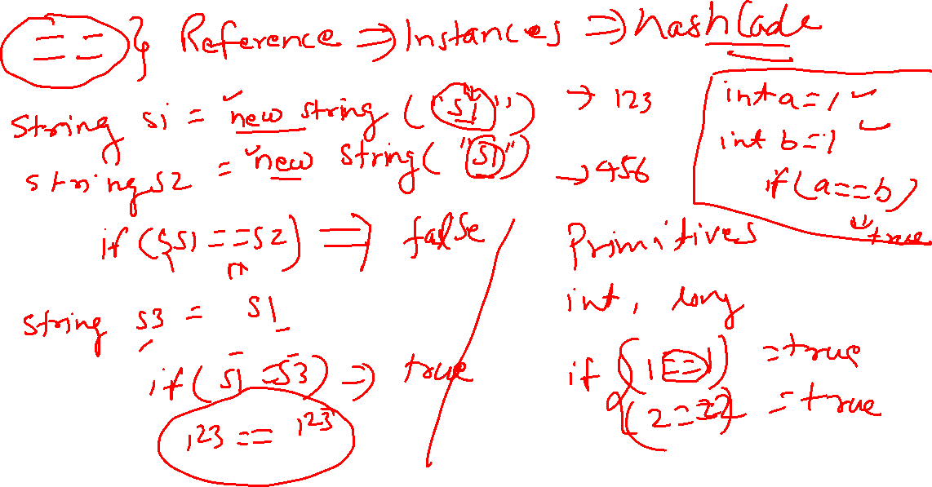

Slide 9
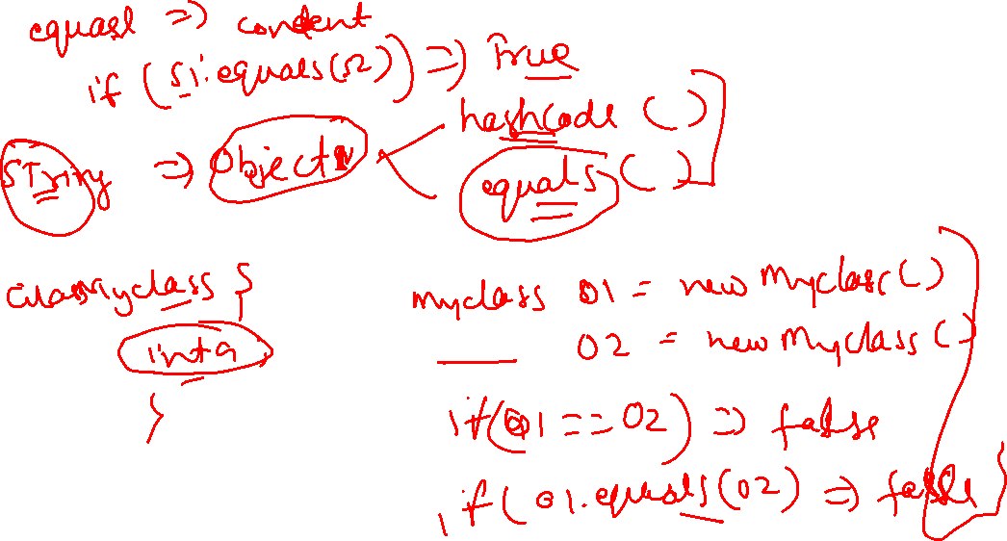

Slide 10
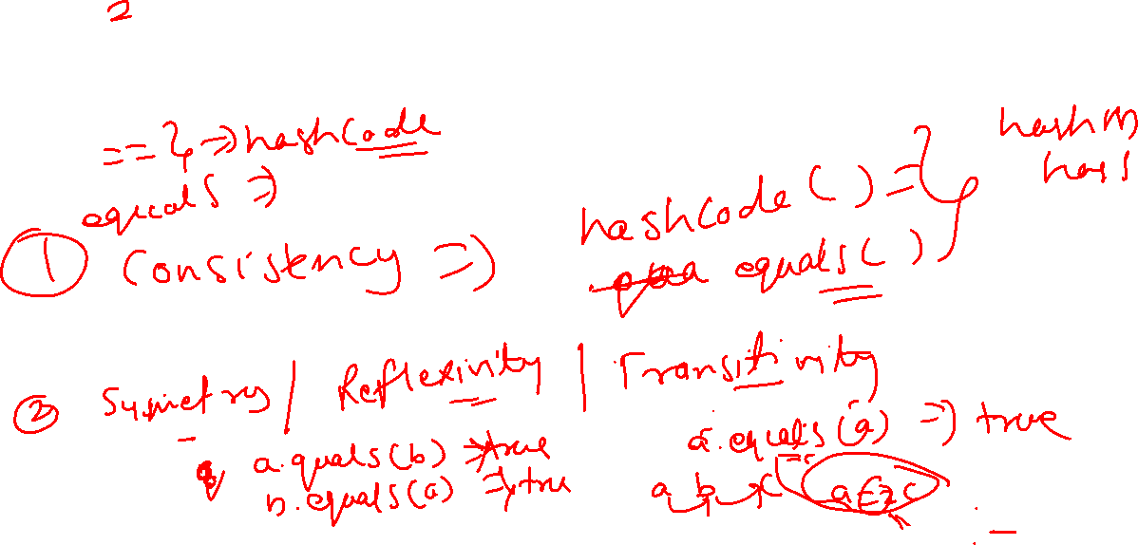
Best Practices

Slide 11
Follow-Up Questions
What is the contract of equals() and hashCode()? Why is it important to override both methods?
Can you explain the difference between == and equals() in the context of String pooling?
What issues might arise if you do not override equals() and hashCode() in your classes?
What is the compareTo() method and how does it relate to equals()?
How would you implement equals() and hashCode() in a class with multiple fields?
How would you store a custom object in a HashMap and ensure that it can be retrieved correctly?

Slide 12
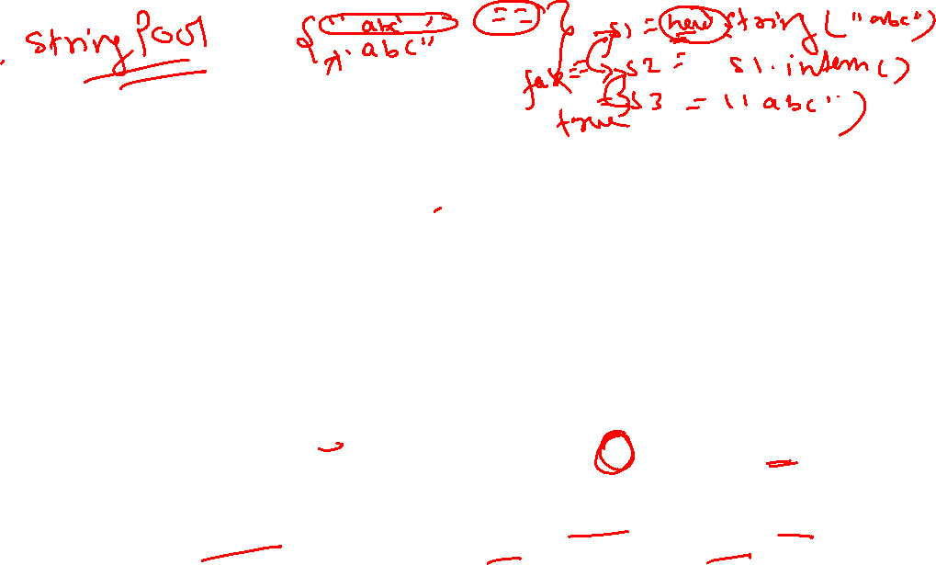
Related Concepts
String Interning: Understanding how String interning works and how it affects the == operator with strings.
Immutability: Discussing immutable objects and how equals() and hashCode() are typically implemented for them.
Comparable vs Comparator: The difference between the Comparable interface (which includes compareTo()) and the Comparator interface (which includes compare()) and their roles in sorting and ordering objects.
Identity HashMap: A specialized Map implementation that uses == instead of equals() for key comparison.
Deep vs Shallow Comparison: Understanding the difference between deep comparison (comparing the contents of the objects recursively) and shallow comparison (comparing references).

Slide 13
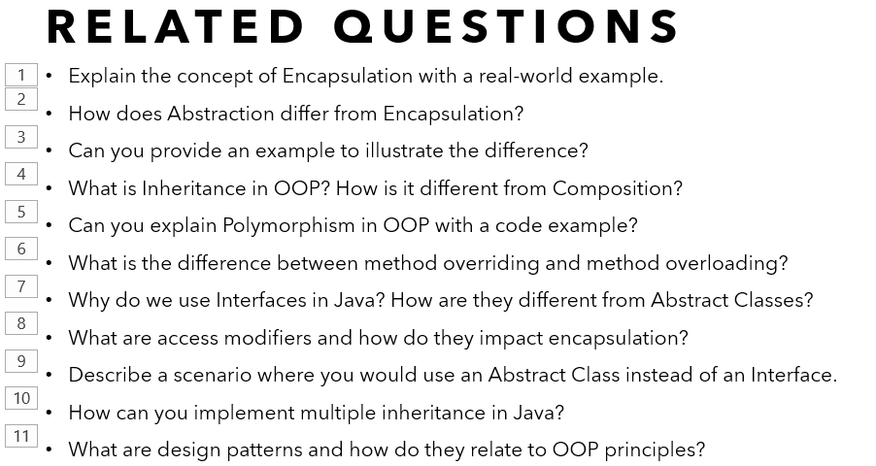
What are the main principles of Object-Oriented Programming (OOP)? **all related questions covered
7
Java Interview
#javainterview#codefarm

Slide 14
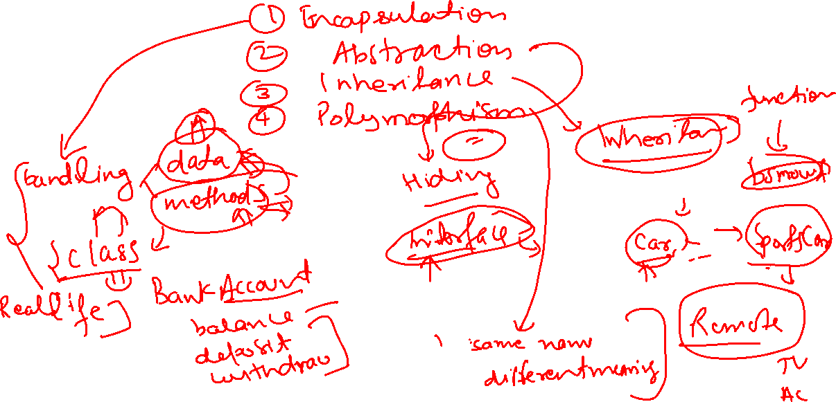

Slide 15
Related concepts
Classes & Objects
Methods
Attributes
Constructor
Access Modifiers
Interface
Abstract Class

Slide 16
Related questions
Explain the concept of Encapsulation with a real-world example.
How does Abstraction differ from Encapsulation?
Can you provide an example to illustrate the difference?
What is Inheritance in OOP? How is it different from Composition?
Can you explain Polymorphism in OOP with a code example?
What is the difference between method overriding and method overloading?
Why do we use Interfaces in Java? How are they different from Abstract Classes?
What are access modifiers and how do they impact encapsulation?
Describe a scenario where you would use an Abstract Class instead of an Interface.
How can you implement multiple inheritance in Java?
What are design patterns and how do they relate to OOP principles?

Slide 17
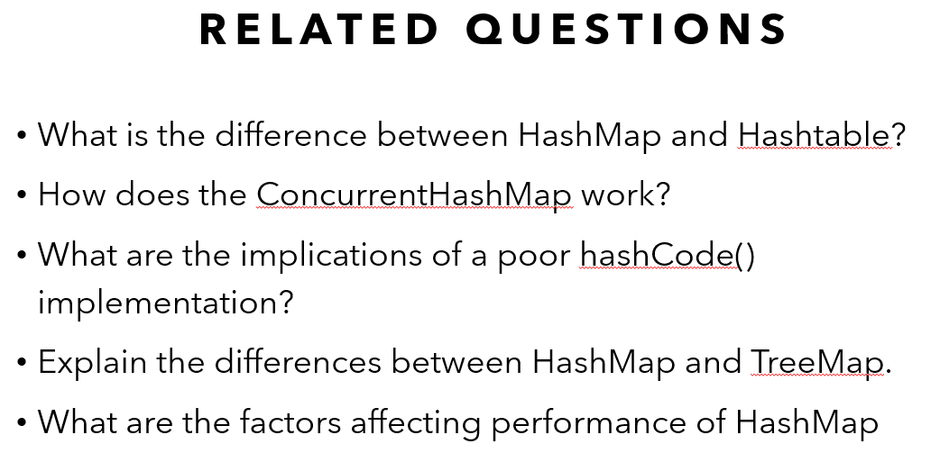
how Hashmap works internally in Java **all related questions covered
8
Java Interview
#javainterview#codefarm

Slide 18
Understanding HashMap Internals in Java

Slide 19
Related Questions
What is the difference between HashMap and Hashtable?
How does the ConcurrentHashMap work?
What are the implications of a poor hashCode() implementation?
Explain the differences between HashMap and TreeMap.
What are the factors affecting performance of HashMap

Slide 20
Usage of hashmap in applications
Caching: HashMap is widely used in caching where fast access to data is required.
Database Indexing: Used for indexing databases for quick data retrieval.
Configuration Storage: Storing configuration settings in applications where quick lookups are needed.

Slide 21
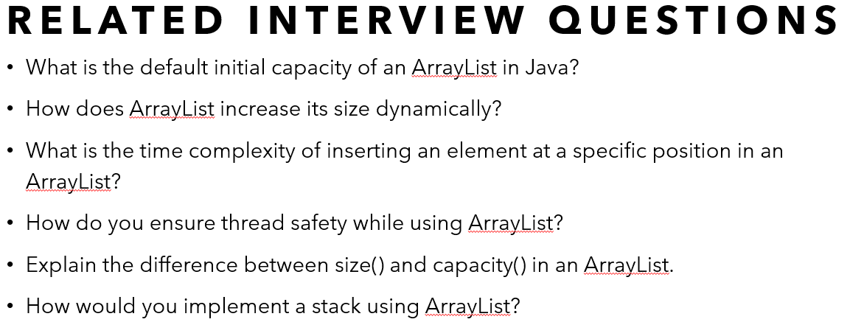
What is the difference between ArrayList and LinkedList in Java **all related questions covered
9
Java Interview
#javainterview#codefarm

Slide 22
How arraylist works internally

Slide 23
Difference between arraylist & linkedlist
Underlying Data Structure
Access Time
Insertion and Deletion
Memory Overhead
Capacity and Resizing
Iteration Performance
Use Cases

Slide 24
related interview questions
What is the default initial capacity of an ArrayList in Java?
How does ArrayList increase its size dynamically?
What is the time complexity of inserting an element at a specific position in an ArrayList?
How do you ensure thread safety while using ArrayList?
Explain the difference between size() and capacity() in an ArrayList.
How would you implement a stack using ArrayList?

Slide 25
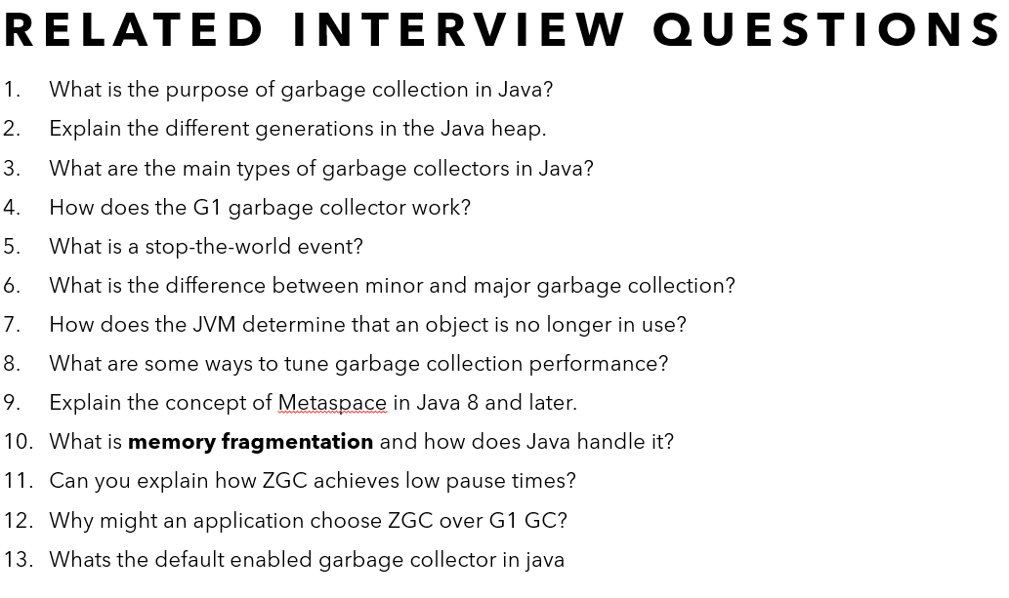
Describe how Java handles memory management and garbage collection **all related questions covered
10
Java Interview
#javainterview#codefarm

Slide 26
Java memory management

Slide 27
Garbage collection

Slide 28
related interview questions
What is the purpose of garbage collection in Java?
Explain the different generations in the Java heap.
What are the main types of garbage collectors in Java?
How does the G1 garbage collector work?
What is a stop-the-world event?
What is the difference between minor and major garbage collection?
How does the JVM determine that an object is no longer in use?
What are some ways to tune garbage collection performance?
Explain the concept of Metaspace in Java 8 and later.
What is memory fragmentation and how does Java handle it?
Can you explain how ZGC achieves low pause times?
Why might an application choose ZGC over G1 GC?
Whats the default enabled garbage collector in java

Slide 29
Explain the process of garbage collection in java **all related questions covered
11
Java Interview
#javainterview#codefarm

Slide 30
process
Marking
Deletion
Compaction

Slide 31
types
Serial Garbage Collector
Parallel Garbage Collector - Throughput Collector
CMS - Concurrent Mark-Sweep Garbage Collector
G1 (Garbage First) Garbage Collector

Slide 32
G1 Garbage Collector
Region-based garbage collector
Divides the heap into multiple equal-sized regions
Performs garbage collection in a manner that prioritizes regions with the most garbage.
Advantages
Predictable Pause Times
Concurrent Execution
Region-based Compaction
Adaptive

Slide 33
G1 Garbage Collector
Tuning
Heap Size
-Xms to set the initial heap size.
-Xmx to set the maximum heap size.
Pause Time Goals
-XX:MaxGCPauseMillis=<N> to set the maximum pause time goal (in milliseconds).
Region Size
-XX:G1HeapRegionSize=<size> to set the size of each region (default is dynamically calculated).

Slide 34
Latest in GC algorithms
Z Garbage Collector (ZGC)
Jdk 11 to 15
Low pause time
Concurrent
Scalable
compaction
Shenandoah Garbage Collector
Jdk 12 to 15
Low pause time
Predictable
Concurrent Compaction

Slide 35
Latest in GC algorithms
G1 Garbage Collector Improvements
Jdk 9 and later
Predictability
Throughput
Mixed collections
Epsilon Garbage Collector
No GC Overhead
Simple
Parallel GC Improvements
Improved Startup
Adaptive sizing

Slide 36
The default garbage collector in Java
JDK 8
Parallel Garbage Collector
JDK 9 and Later
G1 Garbage Collector (Garbage-First)
Check the Default GC
java -XX:+PrintCommandLineFlags –version
Change the GC
java -XX:+UseParallelGC -jar your-application.jar

Slide 37
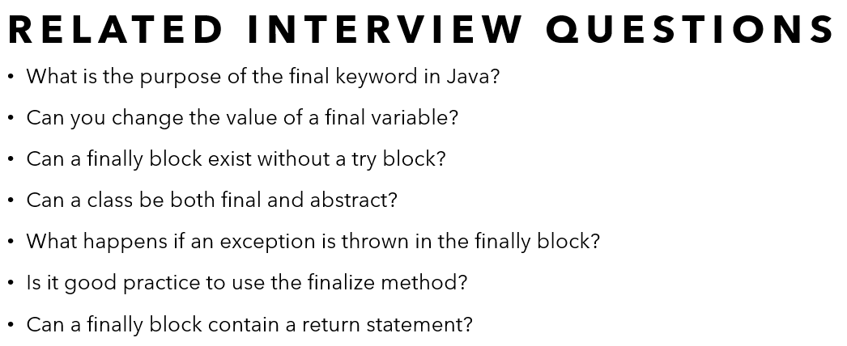
explain the final, finally, and finalize keywords in Java? **all related questions covered
12
Java Interview
#javainterview#codefarm

Slide 38
Final
Variables
Can’t be changed
Class
Can’t be inherited
Method
Can’t be overriden

Slide 39
Finally
Try-catch
Always gets executed

Slide 40
Finalize
Part of Object class
Called by Garbage Collection before object gets destroyed

Slide 41
Related interview questions
What is the purpose of the final keyword in Java?
Can you change the value of a final variable?
Can a finally block exist without a try block?
Can a class be both final and abstract?
What happens if an exception is thrown in the finally block?
Is it good practice to use the finalize method?
Can a finally block contain a return statement?

Slide 42
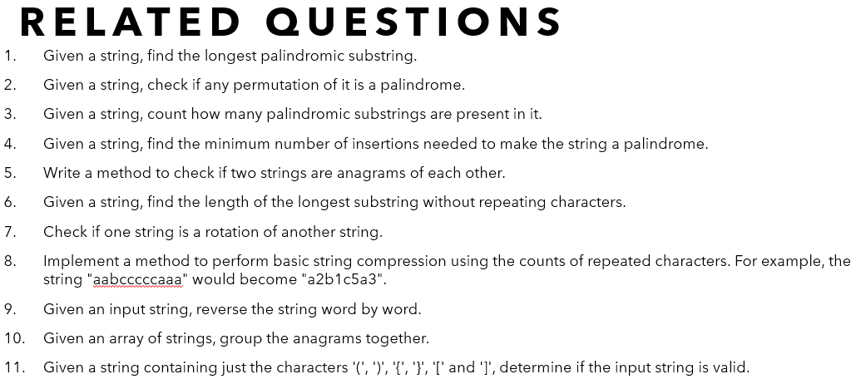
Write a Java method to check if a given string is a palindrome. **all related questions covered
13
Java Interview
#javainterview#codefarm

Slide 43
Approaches
2 pointer
Reverse string
Recursion

Slide 44
Related questions
Given a string, find the longest palindromic substring.
Given a string, check if any permutation of it is a palindrome.
Given a string, count how many palindromic substrings are present in it.
Given a string, find the minimum number of insertions needed to make the string a palindrome.
Write a method to check if two strings are anagrams of each other.
Given a string, find the length of the longest substring without repeating characters.
Check if one string is a rotation of another string.
Implement a method to perform basic string compression using the counts of repeated characters. For example, the string "aabcccccaaa" would become "a2b1c5a3".
Given an input string, reverse the string word by word.
Given an array of strings, group the anagrams together.
Given a string containing just the characters '(', ')', '{', '}', '[' and ']', determine if the input string is valid.

Slide 45
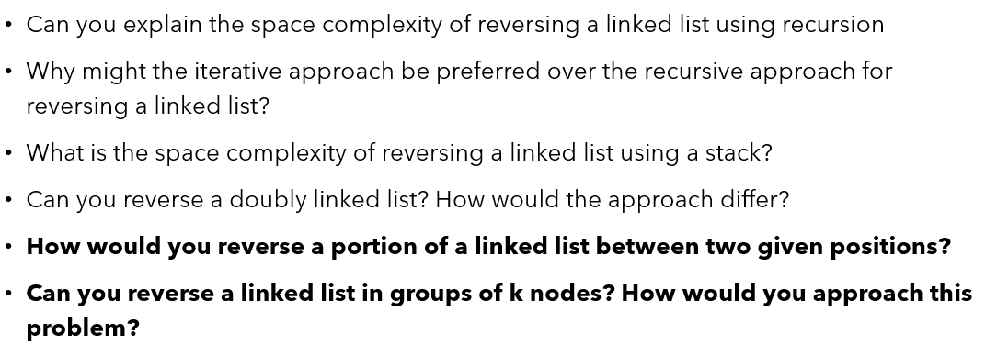
How would you reverse a linked list in Java **all related questions covered
14
Java Interview
#javainterview#codefarm

Slide 46
Approaches
Iterative Approach
Recursive Approach
Using a Stack

Slide 47
iterative
Initialize three pointers: prev as null, current as the head of the list, and next as null.
Traverse the linked list. In each iteration:
Save the next node using next = current.next.
Reverse the link by setting current.next = prev.
Move prev to current.
Move current to next.
After the loop, prev will be the new head of the reversed list.
Complexity
Time – O(n)
Space – O(1)

Slide 48
Recursive
Define a recursive function that takes the current node and the previous node as parameters.
If the current node is null, return the previous node (new head of the reversed list).
Save the next node using next = current.next.
Reverse the link by setting current.next = prev.
Recursively call the function with next and current.
Complexity
Time – O(n)
Space – O(n)

Slide 49
Recursive
Traverse the linked list and push all nodes onto a stack.
Pop nodes from the stack and re-link them.
Initialize a new head using the node popped first.
Continue popping nodes and updating the links until the stack is empty.
Complexity
Time – O(n)
Space – O(n)

Slide 50
Related questions
Can you explain the space complexity of reversing a linked list using recursion
Why might the iterative approach be preferred over the recursive approach for reversing a linked list?
What is the space complexity of reversing a linked list using a stack?
Can you reverse a doubly linked list? How would the approach differ?
How would you reverse a portion of a linked list between two given positions?
Can you reverse a linked list in groups of k nodes? How would you approach this problem?

Slide 51
How would you reverse a linked list in Java **all related questions covered
15
Java Interview
#javainterview#codefarm

Slide 52
Approaches
Iterative Approach
Recursive Approach
Using a Stack

Slide 53
iterative
Initialize three pointers: prev as null, current as the head of the list, and next as null.
Traverse the linked list. In each iteration:
Save the next node using next = current.next.
Reverse the link by setting current.next = prev.
Move prev to current.
Move current to next.
After the loop, prev will be the new head of the reversed list.
Complexity
Time – O(n)
Space – O(1)

Slide 54
Recursive
Define a recursive function that takes the current node and the previous node as parameters.
If the current node is null, return the previous node (new head of the reversed list).
Save the next node using next = current.next.
Reverse the link by setting current.next = prev.
Recursively call the function with next and current.
Complexity
Time – O(n)
Space – O(n)

Slide 55
Recursive
Traverse the linked list and push all nodes onto a stack.
Pop nodes from the stack and re-link them.
Initialize a new head using the node popped first.
Continue popping nodes and updating the links until the stack is empty.
Complexity
Time – O(n)
Space – O(n)

Slide 56
Related questions
Can you explain the space complexity of reversing a linked list using recursion
Why might the iterative approach be preferred over the recursive approach for reversing a linked list?
What is the space complexity of reversing a linked list using a stack?
Can you reverse a doubly linked list? How would the approach differ?
How would you reverse a portion of a linked list between two given positions?
Can you reverse a linked list in groups of k nodes? How would you approach this problem?

